Slide 1
Analysis of Rummy Games: Expected Waiting Times and Optimal Strategies
Christopher Finkle
Advised by Erich Friedman

Slide 2
Review - Rummy Games
Rummy games are played with cards (or sometimes tiles). The player’s goal is to construct melds.
Sets – 3 or 4 cards with the same value
Runs – 3 or more cards in a row with the same suit
Games of this type progress through a draw-and-discard process.
The player’s main decision is which card in the hand to discard.
There are many familiar games in the rummy family: in addition to Gin Rummy, there is Canasta, Mahjong, Rummikub, Tonk, etc.

Slide 3
Review - Ace Handling
Ace Low: The only valid runs containing Aces are of the form A23
Ace High or Low: Aces can also appear in runs like QKA
Round-the-Corner, Continuity, or Ace Wrap: Aces operate like any other card, appearing in runs like A23, QKA, or KA2.

Slide 4

Review - Expected Value and Expected Time
The expected value $E(X)$ of a discrete probability distribution $X$ is
$$E\left(X\right)= \sum_{x}{xP(X=x)}$$
This basic formula is flexible. For example, if we want to know the expected value of one variable $Y$ in relation to another, $X$, we write
$$E\left(Y\right)= \sum_{x}{E\left(Y \right| X=x)P(X=x)}$$
Another useful result: the expected time until a random binary variable with success probability p succeeds is $1/p$.

Slide 5
Review - Solving Rummy
Rummy games cannot be explicitly solved.
However, we can still attempt to determine which decisions are optimal from a probabilistic standpoint.
To do this, we will use the notion of expected value and expected time to find which hands are better than others.
The expected time to rummy, hereafter E, of a hand, will describe the number of turns we expect it to take before the hand can be turned into a Rummy hand.

Slide 6

Review - Dynamic Programming
Dynamic Programming is a recursive technique by which complex problems can be broken into subproblems, whose solutions can then be stored for later use.
Each of the $52−n$ cards we can possibly draw will have an associated optimal hand. Finding the E of this optimal hand is the subproblem.
If we can arrange the calculation so that each of these new optimal Es is known, we can calculate the new E by summing over only $52−n$ values instead of untold billions.

Slide 7
Review - Simplifying Assumptions
In order to make the problem more tractable, we have chosen to omit some aspects of actual Rummy games for now, mostly so that hands can be treated as game-state agnostic.
We assume that discards are placed directly back into the deck at random.
We ignore for now that the player can pick up their opponent’s discard in most Rummy games.

Slide 8

Review - 3-Card Rummy
To simplify things even further, we can invent our own Rummy game, one with only three cards in a hand.
There are now $\left({52 \atop 3}\right)=22,100$ hands to analyze.
If we change the rules of our game so that discards really are put back in the deck, our dynamic programming approach will fully describe the reality of the game.
3-Card Rummy is used here to illustrate more concretely the theoretical techniques we developed. These techniques are applicable to any Rummy game.

Slide 9




Theorem: A Hand’s $E$ is determined only by hands with lesser $E$s.
We proved this by induction during the proposal stage.
It is the foundation upon which all subsequent work rests.
The upshot is that we may calculate a single value for E for each hand by performing the Expected Time calculation based on data from successive generations, starting from the known hands – those which are Rummy.

Slide 10
Re-implementing the Program
Last semester the program was written suboptimally in Python.
This semester the entire thing was rebuilt with flexible, high-performance C++ code that takes advantage of lots of caching to speed up the process.

Slide 11
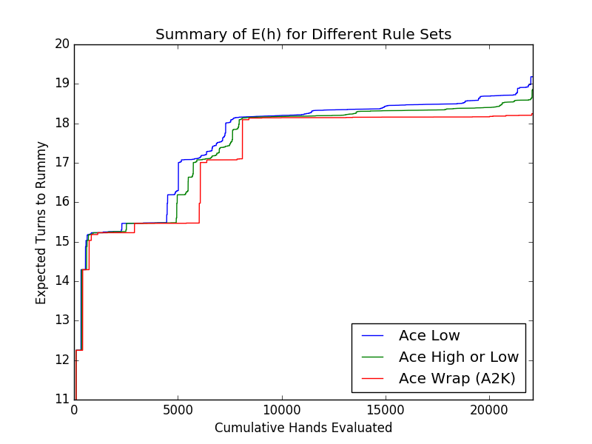
Results for 3-Card Rummy
Rule: | Ace Low | Ace High | Ace Wrap
# of classes | 713 | 724 | 59
Highest E | 19.18 | 18.86 | 18.24
Time required | ~33 min | ~35 min | ~0.5 min

Slide 12

4-Card Rummy
Factorial-polynomial rise in complexity as we add cards.
4-Card rummy has $\left({52 \atop 4}\right)=270,725$ hands to worry about.
There is a commensurate rise in the number of symmetries.
Everything must trace back to just 53/57/65 Rummys for Low/High/Wrap.
Based on the 3-card calculations, we expect Wrap rules to be most manageable.

Slide 13
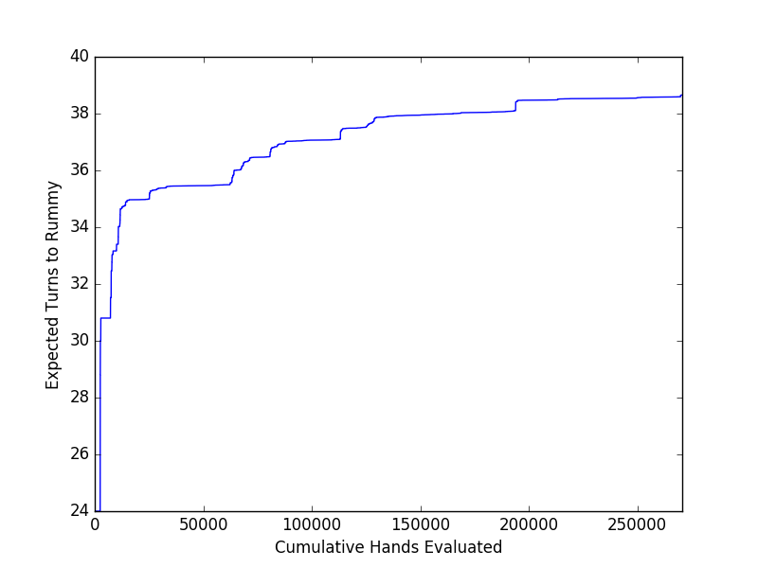
4-Card Ace Wrap Results
Ran in ~3 hours
654 classes
Median hand has E = 37.897
Worst hand has E = 38.656

Slide 14
Motivating Approximation
For problems larger than 4-Card Continuity Rummy, even a summary of the full results will quickly become unwieldy.
If the ratio of symmetries is similar we would expect 4-Card Ace Low to possess 7000 equivalence classes and take 33 hours to run.
7-Card Rummy is even worse.
It is time to switch from seeking optimal to satisficing solutions.
If we can approximate E with manageable accuracy we can get useful information about the general quality of hands without needing to know everything down to the 8th decimal place.

Slide 15



Illustration of the Bounding Process
One way to get an upper bound for E is to define an intentionally suboptimal strategy and see how long we expect it to take.
Here is a particularly obtuse strategy for 3-Card Rummy: Wait until you get a pair which two cards could potentially complete. Then complete the pair.
For example, consider what is for Ace Low rules a worst-case hand like: Which has eleven cards that make pairs.
We expect it to take 49/11 turns to make a pair, then 49/2 to complete it. So an upper bound for 3-Card Ace Low is 29 turns.

Slide 16
Refining the Bound
What if our strategy is not so obtuse? How can we integrate multiple types of ‘goal hand’ and extend the chain of successive bounds to arbitrary length?
Turns out we already developed a tool which does this to calculate the actual Es, called the Bellman Sum.
Due to machine arithmetic we already had to define a certain tolerance when considering hands to finalize.
Changing that tolerance to different values allows us to approximate with varying levels of precision.

Slide 17
Controlling Errors
The approximation scheme from the previous slide is only useful if the error fails to grow with each iteration.
We may prove that for an approximation with tolerance = t, a given hand will have error E* - E < t.
This may be proved by induction but it may be intuitively understood by imagining the suboptimal strategy which is equivalent to iterating the Bellman sum with tolerance t.

Slide 18
Outline of Proof that Errors are Bounded by t
For a given hand h recall that E(h) is determined by the finalized E of each potential future hand.
By inductive hypothesis, if a hand is already finalized it has error of less than t.
If a hand that would enter the calculation under normal circumstances has not yet been locked in, it must have an E that is within t of E(h), so assuming that that hand does not contribute to E(h) introduces error of no more than t.
If the error in each term of the Bellman sum is no more than t, then the error of the sum itself will be less than t.
In strategic terms, we jump to a new hand only when its expected time improves upon our current E by t or greater.

Slide 19
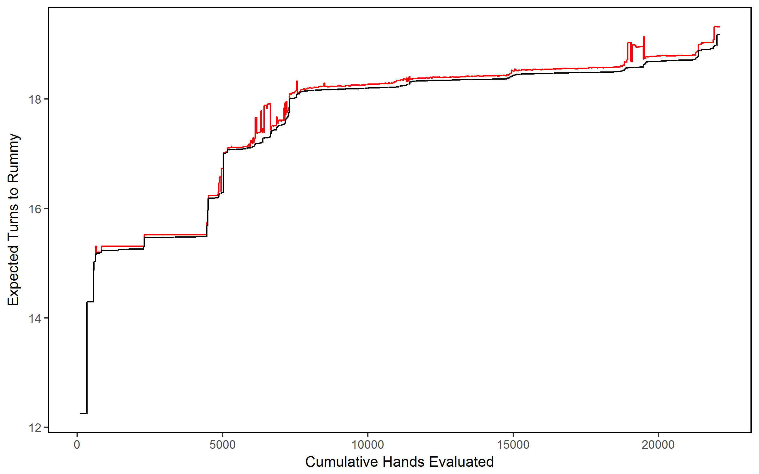
Approximation of 3-Card Ace Low (t=1)
Red line shows approximations; error never exceeds 0.7.
Runs in seconds
Hands are swept into only 9 cohorts

Slide 20
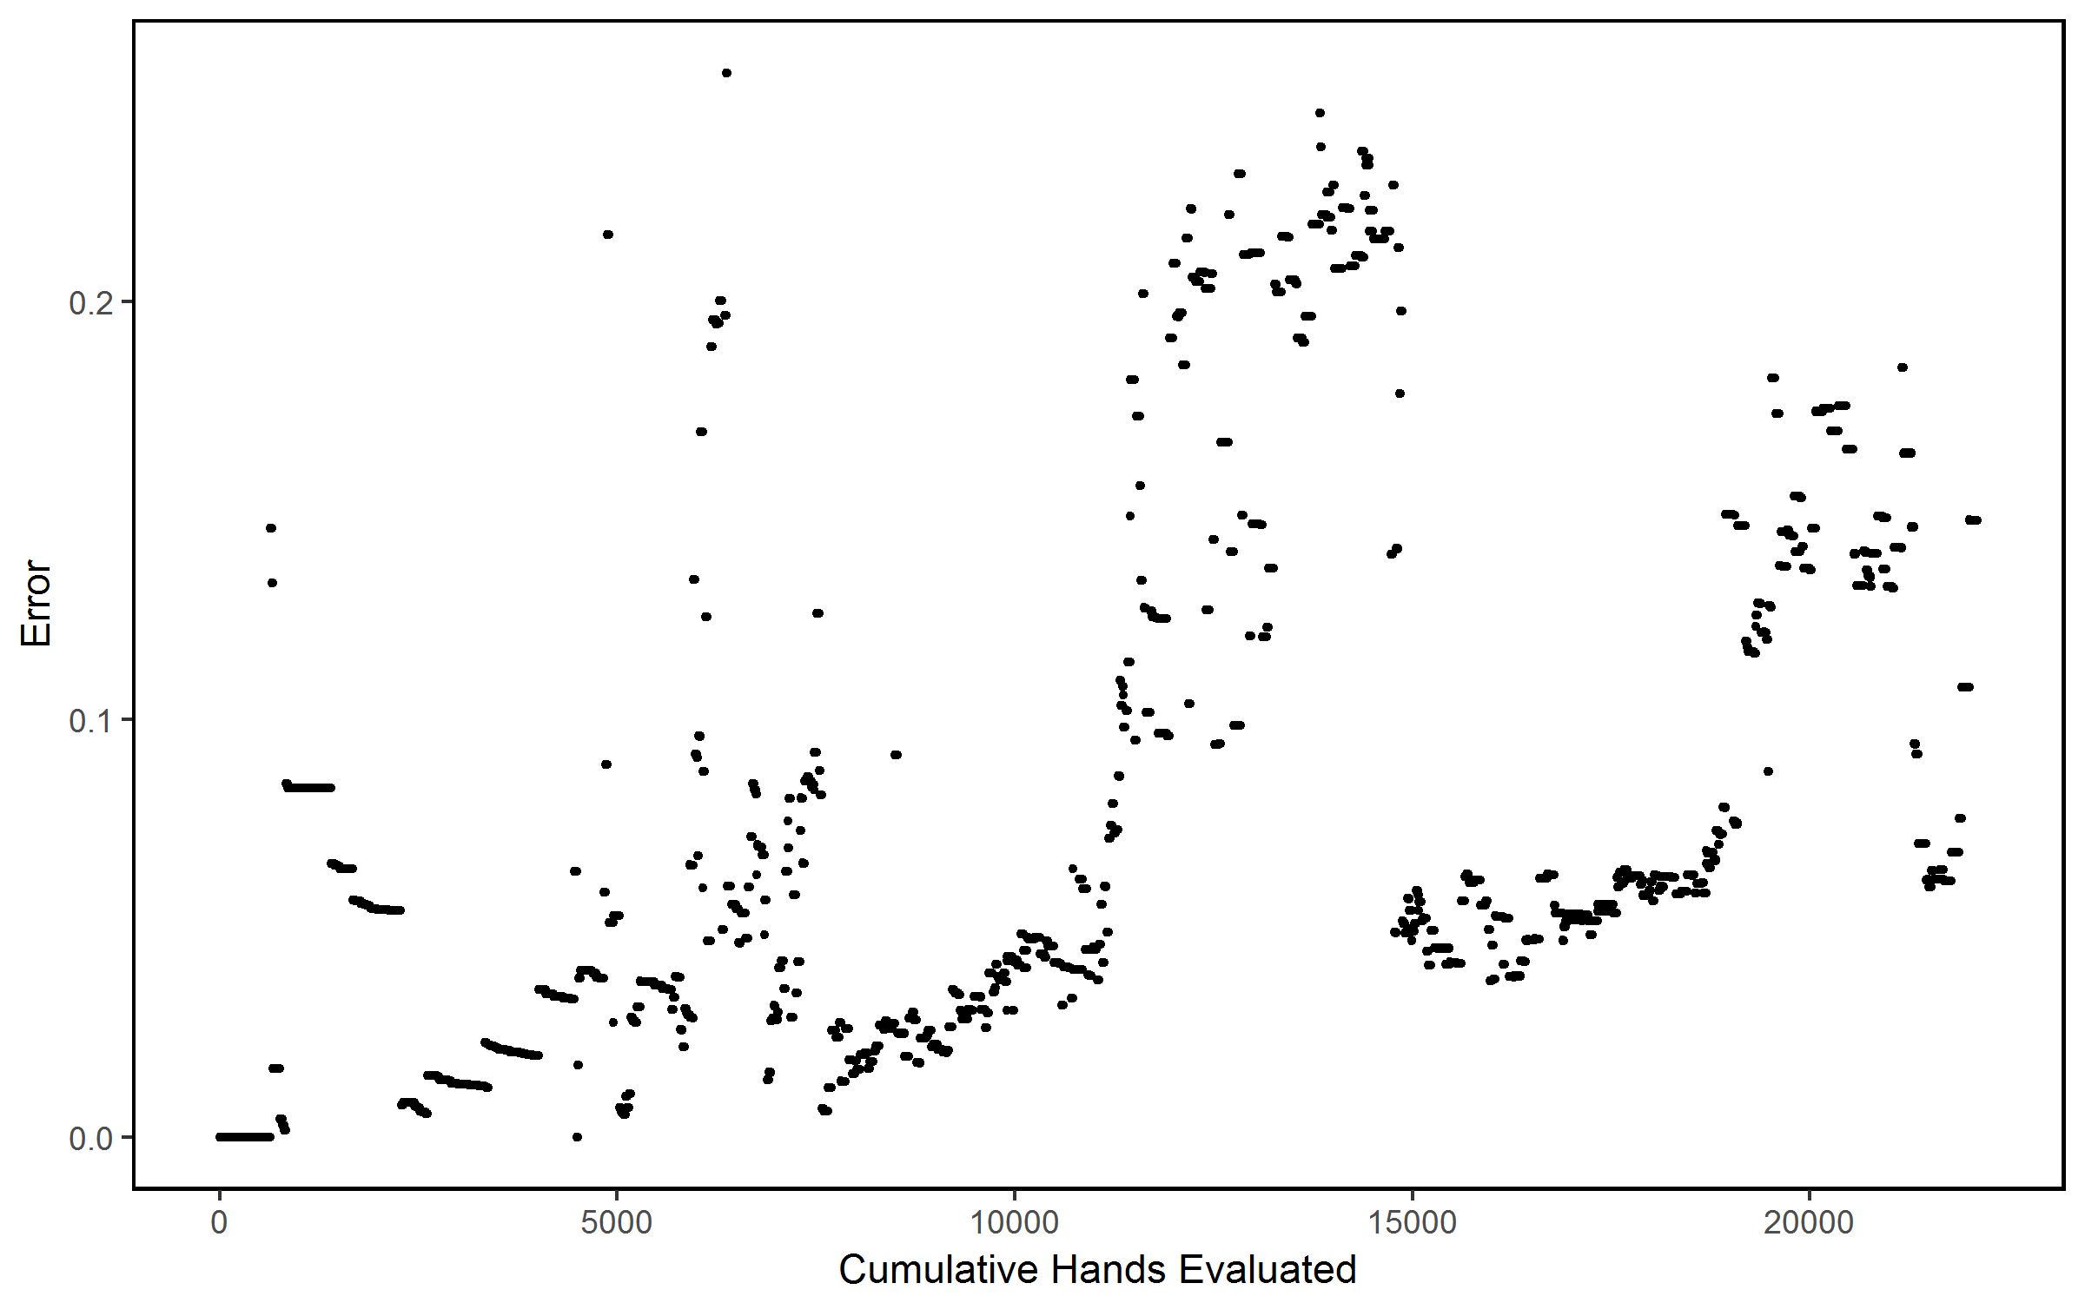
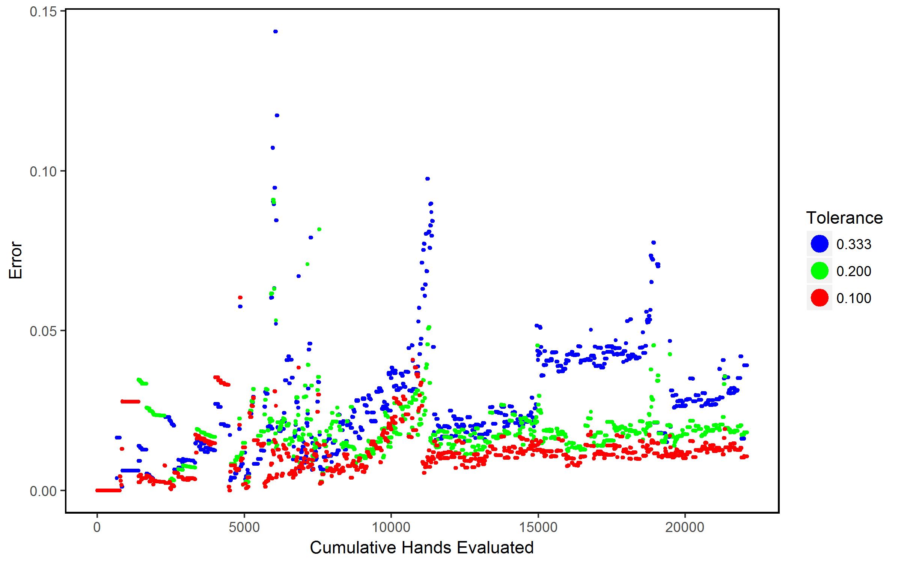
Residuals for Other t Values
t = 0.5

Slide 21
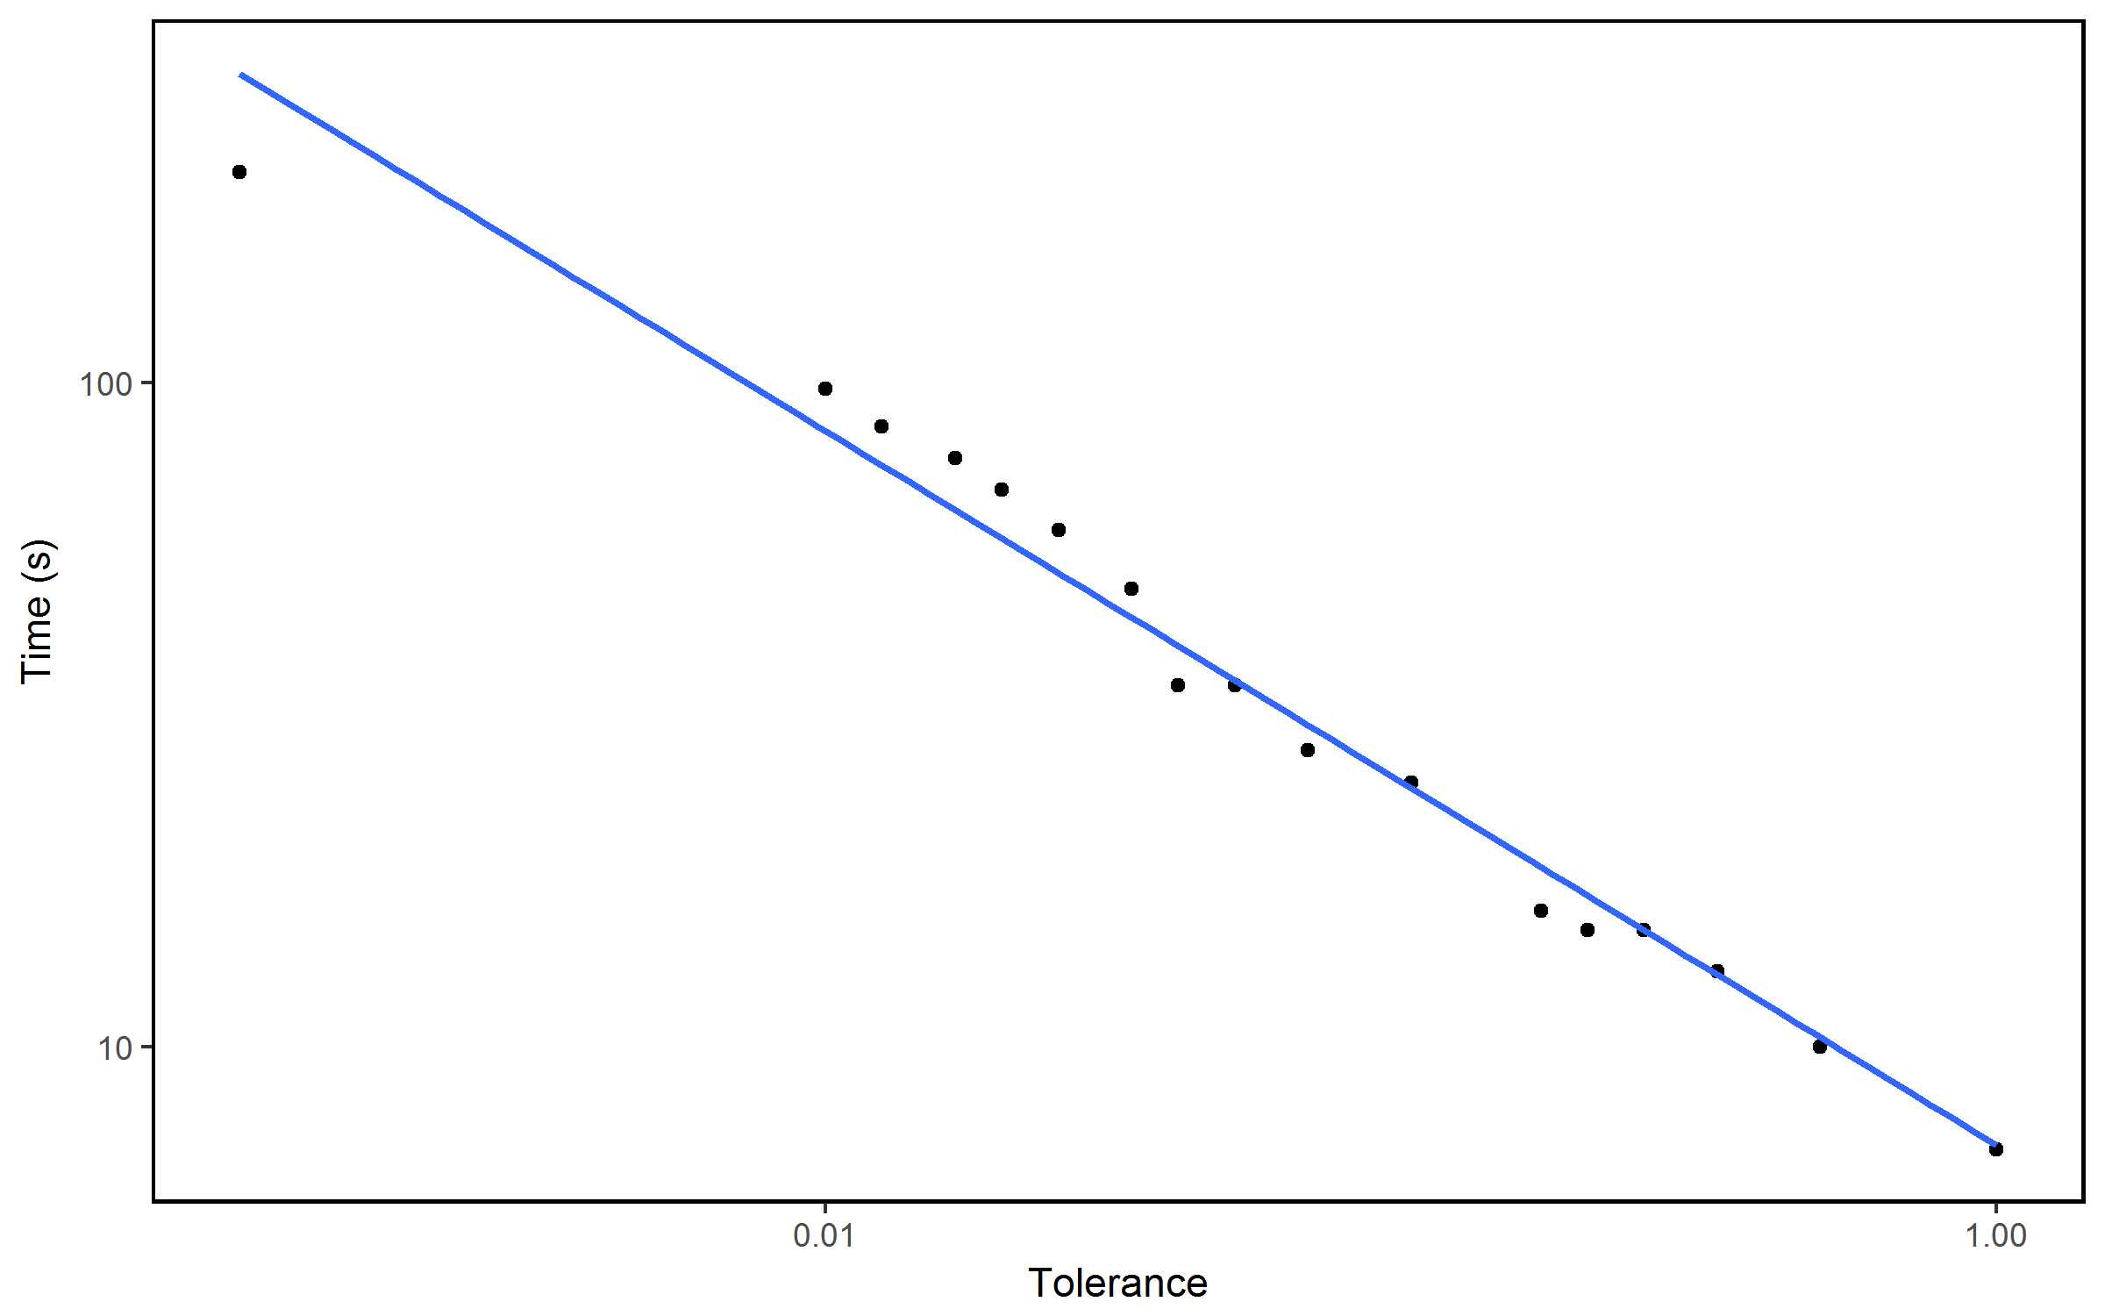

Computation Time vs. Tolerance
3-Card Ace Low
3-Card was run with 17 tolerances and the calculation times monitored.
The resulting relationship was $Time=αt^{−0.538}$
Using this regression the calculation time for our ‘real’ version corresponds with $t=2.7∗{10}^{−5}$.

Slide 22
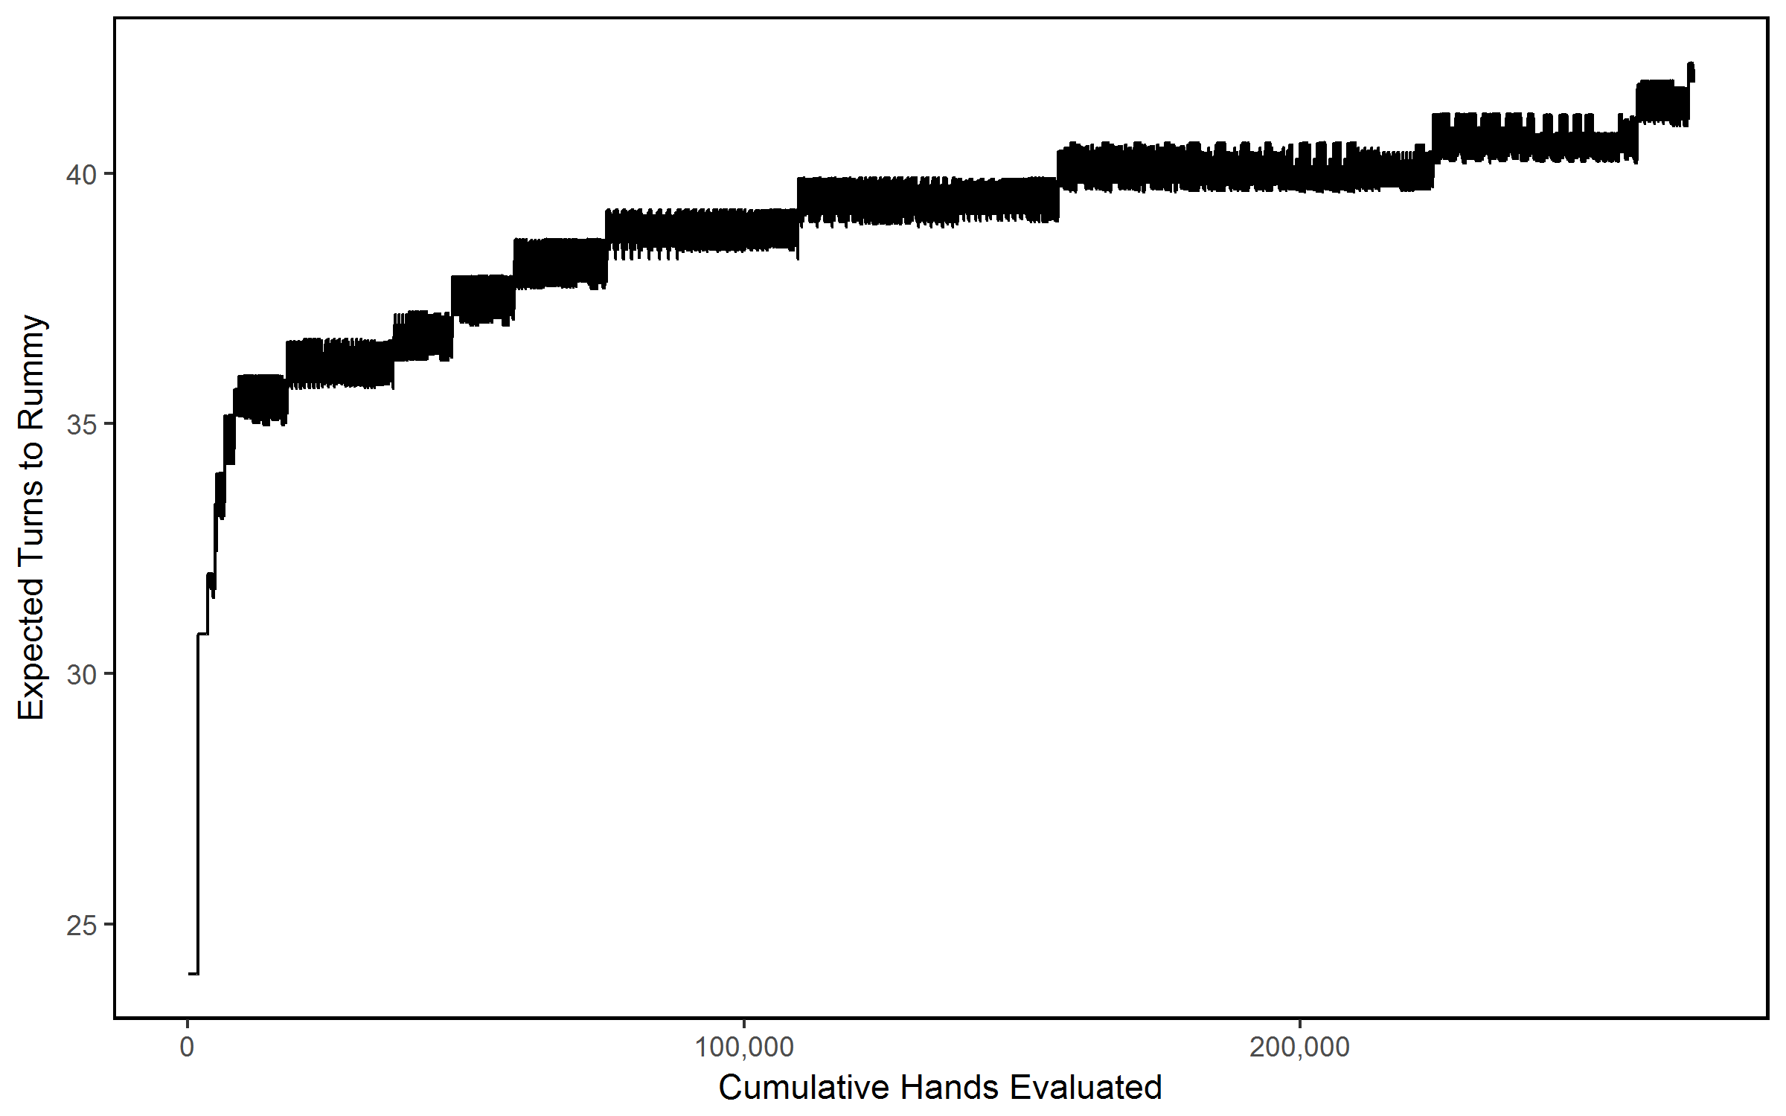
Approximation of 4-Card Ace Low
Without a true ordering to organize by, the data look ‘fuzzy’.
Ran in 225 seconds
19 cohorts

Slide 23
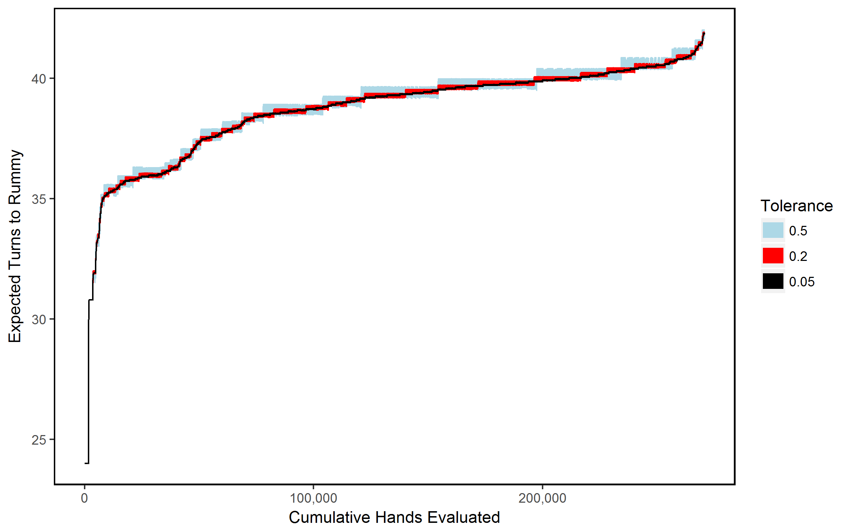
Refining the 4-Card Approximation
As we decrease the tolerance, our calculations converge to a central curve.
However, the computation time grows faster than it did for 3-Card.
With enough samples of t we can create another regression.

Slide 24
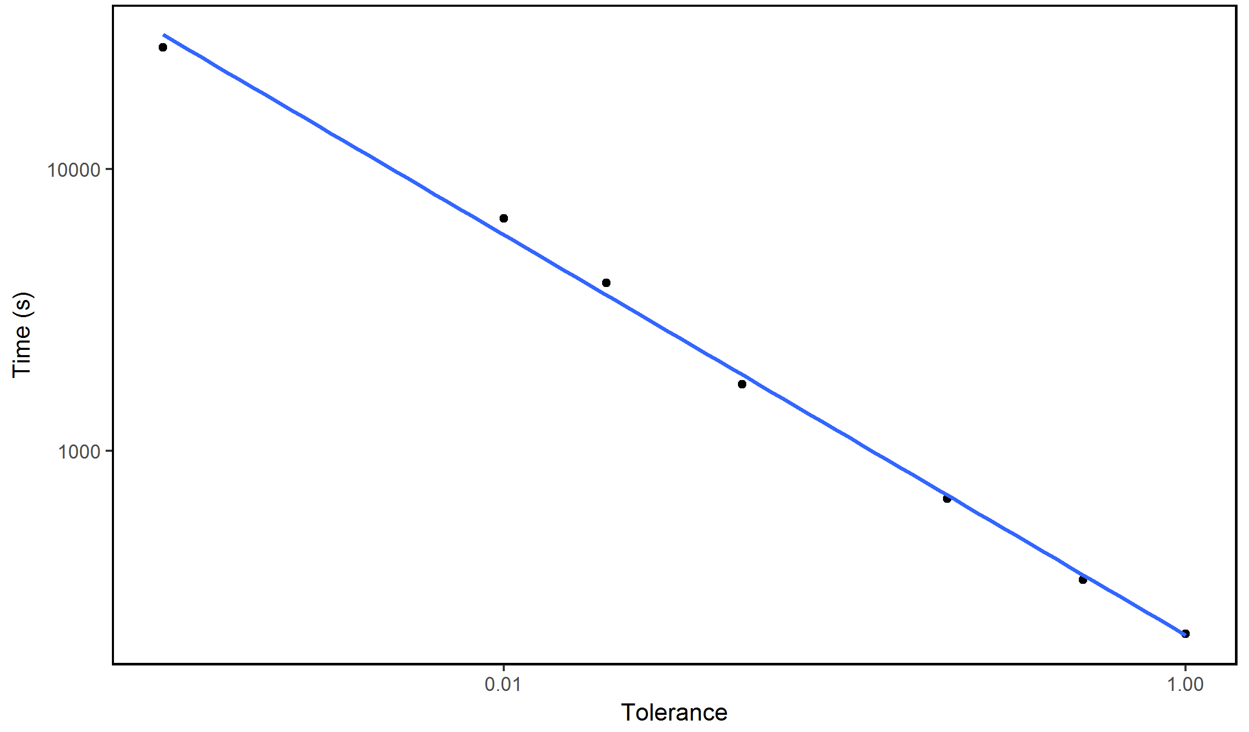

Time Regression for 4-Card
4-card Ace Low
Once again we acquire an exponential relationship: $Time= βt^{−0.710}$.
Plugging in the regressed value for a complete calculation from 3-Card we estimate it would take 121 hours to compute all E for 4-Card Ace Low at full precision – inconvenient!

Slide 25
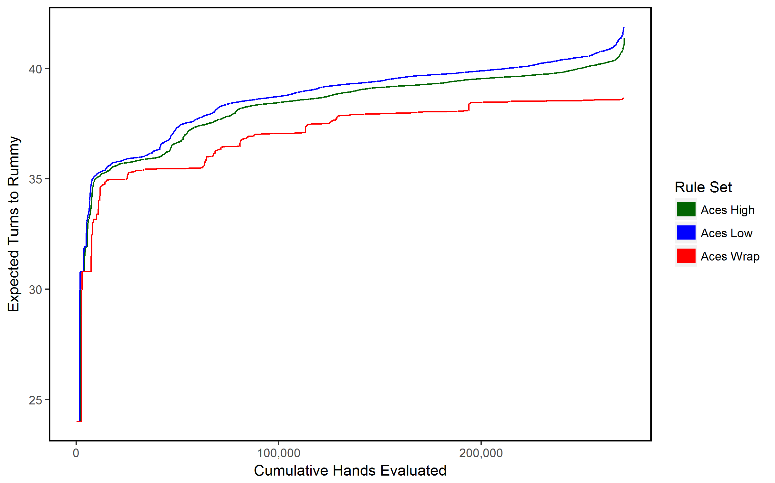

4-Card Rummy Aces High
We decided that t=0.001 provided a fine tradeoff between speed and accuracy.
The graph shows values precise to within ${10}^{−3}$ for Ace High and Low, and within ${10}^{−8}$ for Ace Wrap.
Ace High and Ace Low remain close together.

Slide 26
A Word on 7-Card Rummy
While we were not able to gain any great insight into 7-Card Rummy, we can construct a poor upper bound for E using a highly suboptimal bounding process.
For a given 7-Card hand, partition it into a 4-Card and 3-Card subhand. First complete the 3-Card meld according to the policy function we have found, then complete the 4-Card hand.
Using this strategy the upper bound for E will be the sum of the upper bounds for 3- and 4-Card Rummy: 61.067 turns for Aces Low.

Slide 27
Potential Future Research
If we may work out some better way to combine Es for 3- and 4-Card subhands of 7-Card hands, a better bound for 7-Card Rummy could be found.
We might attempt to determine the variance about a given hand’s E, which after all is calculated as the mean expected time to Rummy.
By playing computerized game agents with game knowledge of varying completeness against each other we could attempt to establish a relationship between win rate and knowledge accuracy, perhaps allowing a statistical analysis of what percentage of success probability in Rummy is skill vs. luck.
Our version of Rummy continues to lack many features of its real-world counterparts. We might try to find economical ways to add these to the calculations.

Slide 28
Sources
Bellman, Richard E. (1957). Dynamic Programming. Princeton, NJ: Princeton University Press.
Gibson, Walter. (1974). Hoyle’s Modern Encyclopedia of Card Games. New York: Doubleday
Kotnik, Clifford, & Kalita, Jugal (2003). The significance of temporal-difference learning in self-play training td-rummy versus evo-rummy. In ICML (pp. 369- 375).
Parlett, David. (1978). The Penguin Book of Card Games. London: Penguin

